Slide 1
Data Science Basics in R:
Day 1

Slide 2
Introduction

Slide 3
Housekeeping notes

Slide 4
What to expect

Slide 5
Workshop goals

Slide 6
Goals for today

Slide 7
What is statistical programming?

Slide 8
What is R?

Slide 9
Why learn R?

Slide 10
What is R Studio?

Slide 11
Getting familiar with R Studio

Slide 13
R Basics

Slide 14
Objects

Slide 15
Functions

Slide 16
Syntax

Slide 17
Documentation

Slide 18
Thank you!
See you tomorrow.
Please come with a fully charged laptop.
Lecture and course material adapted from Intro to R materials created by Alex Douglas, available online here, with corresponding free online textbook.

Slide 19
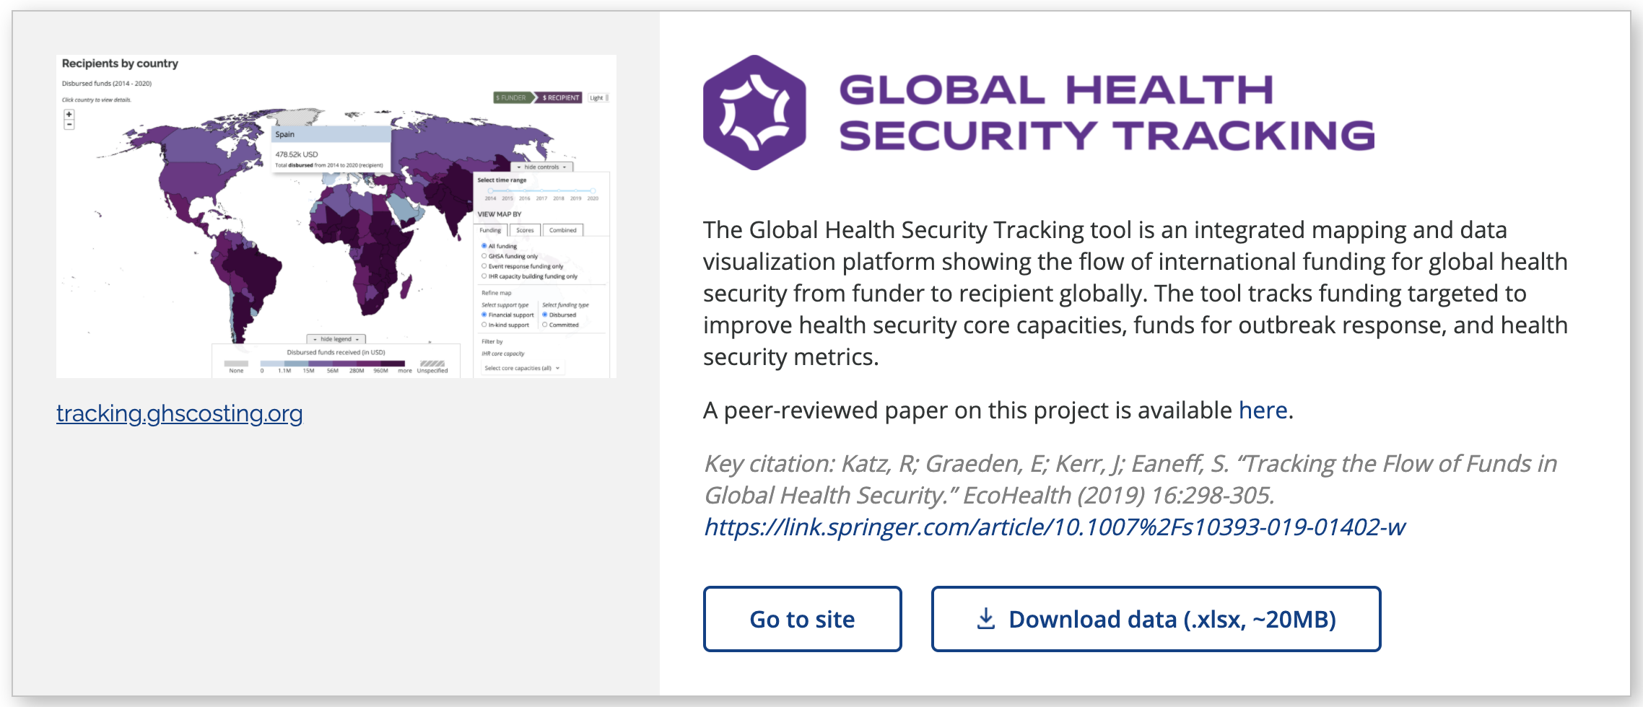

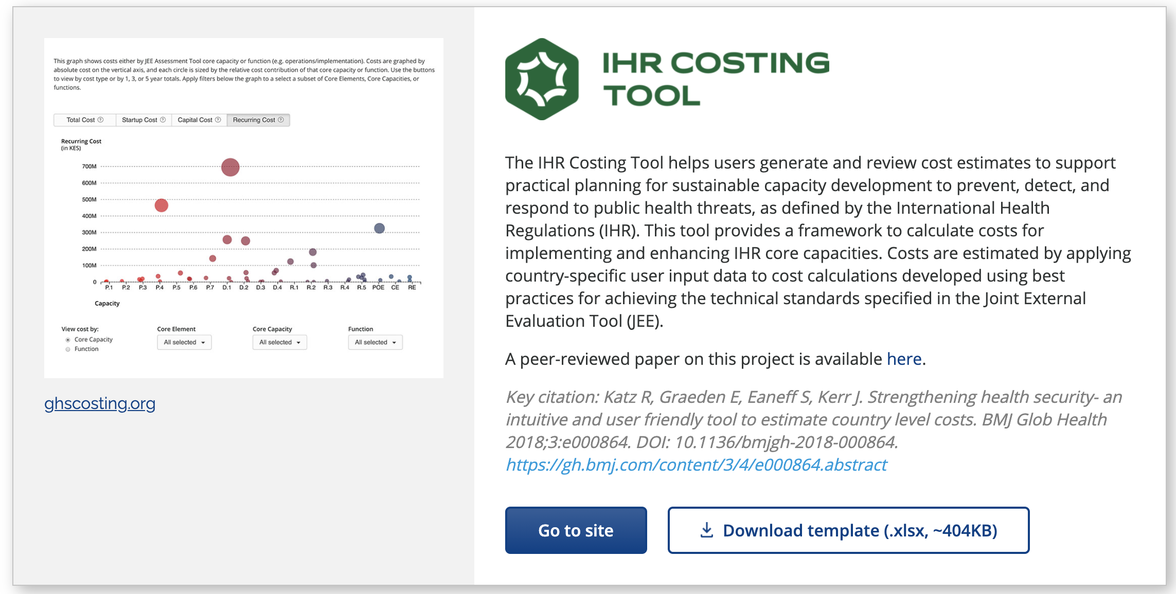

Open-source tools for global health funding and policy (ghsidea.org)
Notes:
RK do slide.
We’ve been working on this for a while. Started costing IHR about a decade ago. To help countries build a business case for investing in IHR implementation.
It is now part of a large suite of tools that are connected on the back end through GHSIDEA.org
Everything we do is publicly available and we make the back end spreadsheets availalb.e
RK do this slide.
IHR costing tool is a publicly available, online tool to estimate country-level costs to build health capacity
aligned to benchmarks identified in first edition JEE
incorporates guidance from WHO, OIE, & global experts
estimates 5-year costs to achieve “demonstrated capacity”
Tool has been used and validated at the country-level, including to develop specific costed national action plans that identify prioritized and costed activities
We developed a tool. People/orgs used it. Available online in English and French and always made the back end spreadsheets available.
It estimates country level costs to reach a 4 (not a 5)
- aligned to the benchmarks for health security capacity that are part of the WHO monitoring framework
Its been used an validated, including to develop specific costed national action plans
BUT

